Slide 1



MyMedicare
Angela How, Brisbane South PHN
BETTER SYSTEM, BETTER HEALTH

Slide 2

Acknowledgement of country
Baugull nyungai
Gurumba bigi
Maroomba biggee
We acknowledge the Traditional Custodians of the land on which we live and work, and of the many different nations across the wider Brisbane south region.
We pay our respects to the Elders, past, present and emerging, as the holders of the memories, the traditions, the culture and the spiritual wellbeing of the Aboriginal and Torres Strait Islander peoples across the nation. We acknowledge any Sorry Business that may be affecting the communities as a whole.
In the spirit of reconciliation, partnership and mutual respect, we will continue to work together with Aboriginal and Torres Strait Islander peoples to shape a health system which responds to the needs and aspirations of the community.

Slide 3
Introduction to MyMedicare

Slide 4
MyMedicare overview
What is MyMedicare and how can it help me?
MyMedicare is a voluntary patient registration scheme.
It aims to formalise the relationship between you and your preferred primary care provider, to strengthen continuity of care.
MyMedicare was announced as a platform to drive improvement in the continuity and quality of primary health care for all Australians.

Slide 5
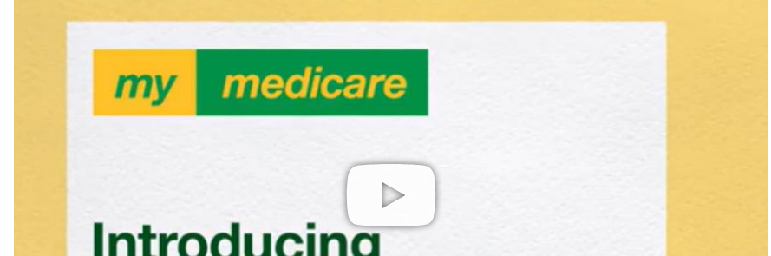
Video: Introducing MyMedicare
Watch the introduction video from the Department of Health and Aged Care at https://youtu.be/PvCNs8iFAbg?si=bcorvkdaS9jsA8cG

Slide 6
MyMedicare: improved continuity of care
We all want care that is:
Formalise care relationships and embed continuity of care into the health care journey.
Make the GP/practice the reference point for you, as the patient.
Be voluntary for patients, practices and providers.
Provide better communication about consumers back to their nominated care provider.
Accessible
Comprehensive
Coordinated
MyMedicare aims to:
Person-centred
Continuous
Registering with your GP and confirming that they are your preferred care provider helps them to better understand who their patients are and address the specific needs of their population.

Slide 7
MyMedicare eligibility
PRACTICES/AMS
Registration opened 1 July 2023
Accredited or working towards accreditation
(and other certain exemptions)
PROVIDERS
Registration opened 1 July 2023
Registered GP and practice will be visible in My Health Record
Must work at MyMedicare eligible practice
*exemptions available for providers delivering services through mobile and outreach (rural, residential aged care, disability residential settings, First Nations people and those experiencing homelessness.
PATIENTS
Registration opened 1 October 2023
Medicare card or DVA veteran card
Can register themselves online (MyGov) or be assisted by the practice
MMM 6-7, AMS/ACCHOS 1 visit in 12 months
Need to have been to the practice twice in 2 years
Encompassing family units

Slide 8
MyMedicare benefits

Slide 9
MyMedicare benefits
MyMedicare registration will provide access to:
  greater continuity of care
  longer MBS funded telehealth consultations with registered GP
  triple bulk billing incentive for longer telehealth consultations (if eligible for bulk billing incentive)
  more regular visits from GP for people living in residential aged care homes (from Aug 2024).

Slide 10
MyMedicare benefits: billing
MyMedicare offers greater bulk billing options
Item level | Face to Face | Telephone | Video Call
A | Standard bulk billing incentive | Standard bulk billing incentive | Standard bulk billing incentive
B | Triple bulk billing incentive | Triple bulk billing incentive | Triple bulk billing incentive
C | Triple bulk billing incentive | MyMedicare Triple bulk billing for registered patients | MyMedicare Triple bulk billing for registered patients
D | Triple bulk billing incentive | MyMedicare Triple bulk billing for registered patients | MyMedicare Triple bulk billing for registered patients
E | Triple bulk billing incentive | Standard bulk billing incentive | MyMedicare Triple bulk billing for registered patients

Slide 11




Next steps for MyMedicare
August 2024
From Nov 2024
In the Future
Frequent Hospital User (FHU) incentive
General Practice in Aged Care Incentive (GPACI)
MBS items for chronic disease management restructured and tied to registered practice
Additional cohorts likely to be incentivised
These arrangements will roll out progressively across the country over 3 years from the 2024–25 financial year.

Slide 12
Registering for MyMedicare

Slide 13
MyMedicare registration
3 ways to register for MyMedicare:
1. Patient-initiated
Patient starts the registration process in their Medicare Online Account.
Practice accepts the registration in the MyMedicare system.
2. Practice-initiated
Practice starts the registration process in the MyMedicare system.
Patient accepts the registration in their Medicare Online Account.
3. MyMedicare Registration Form
Patient completes the MyMedicare registration form and provides it to practice staff.
Practice staff complete the registration in the MyMedicare system.

Slide 14
Important note:
MyMedicare registration requires joint consent.
A registration in MyMedicare is only successful when both you and your practice have provided consent to formalise your relationship through one of the registration processes outlined in the previous slide.

Slide 15
Registration changes
Can I make changes to my MyMedicare registration?
  Yes. You can change your MyMedicare GP or general practice at any time.
  You can withdraw from MyMedicare at any time.
  These changes can be made through your Medicare Online Account, with your practice.

Slide 16
MyMedicare myth-busting

Slide 17
MyMedicare Myths
Myth
You can continue to see other GPs and health professionals at other practices, at any time.
You can change your preferred GP with your registered practice, at any time.
You can register with a new practice, once you both meet the eligibility requirements.
Registering in MyMedicare means I can only see the nominated GP.
Instead...
MYTH:
If you are aged under 16, a pension or concession card holder – you will be eligible to be bulk-billed for longer telehealth consultations.
Face-to-face appointments will be charged in accordance with the usual billing arrangements.
If I register for MyMedicare, I will be bulk-billed for all my GP appointments.
Instead...

Slide 18
MyMedicare myths and facts
Myth:
Registering in MyMedicare means I can only see the nominated GP.
Facts:
You can continue to see other GPs and health professionals at other practices, at any time.
You can change your preferred GP with your registered practice, at any time.
You can register with a new practice, once you both meet the eligibility requirements.

Slide 19
MyMedicare Myths
MYTH:
You do not need to have My Health Record to participate in MyMedicare.
Practice registration and GP nomination will be recorded on the registered general practice software and in your My Health Record, unless you choose not to display this.
I will need to have My Health Record to register for MyMedicare.
Instead...
MYTH:
You can nominate another GP in your registered practice, or you can register with your nominated GP at their new practice (without having to meet any new eligibility requirements).
If my nominated GP moved to another practice, I would have to see a different GP at my registered practice.
Instead...

Slide 20
Further information

Slide 21
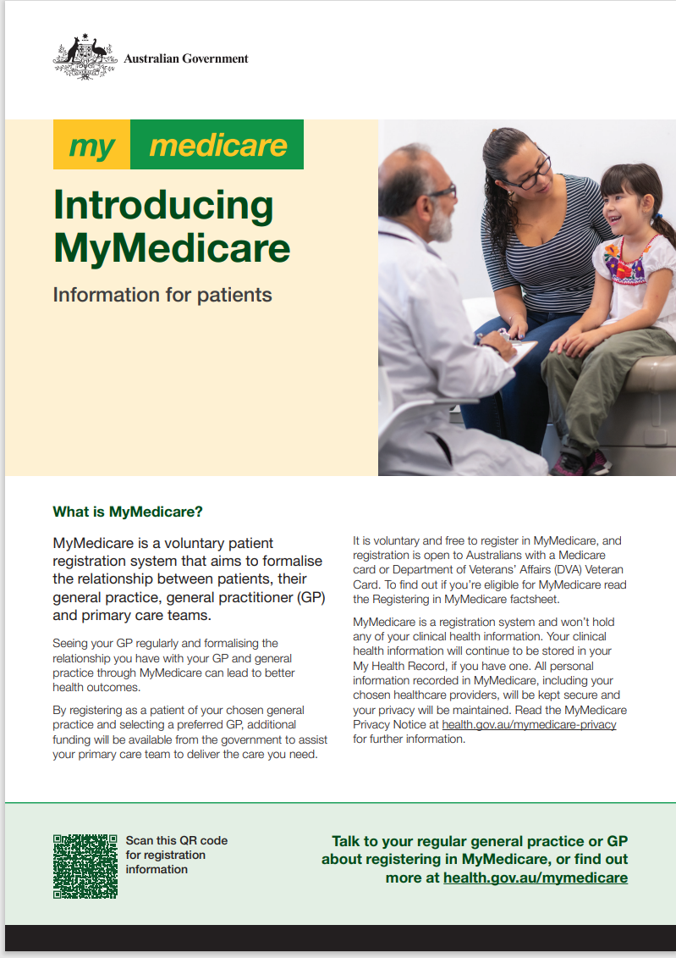

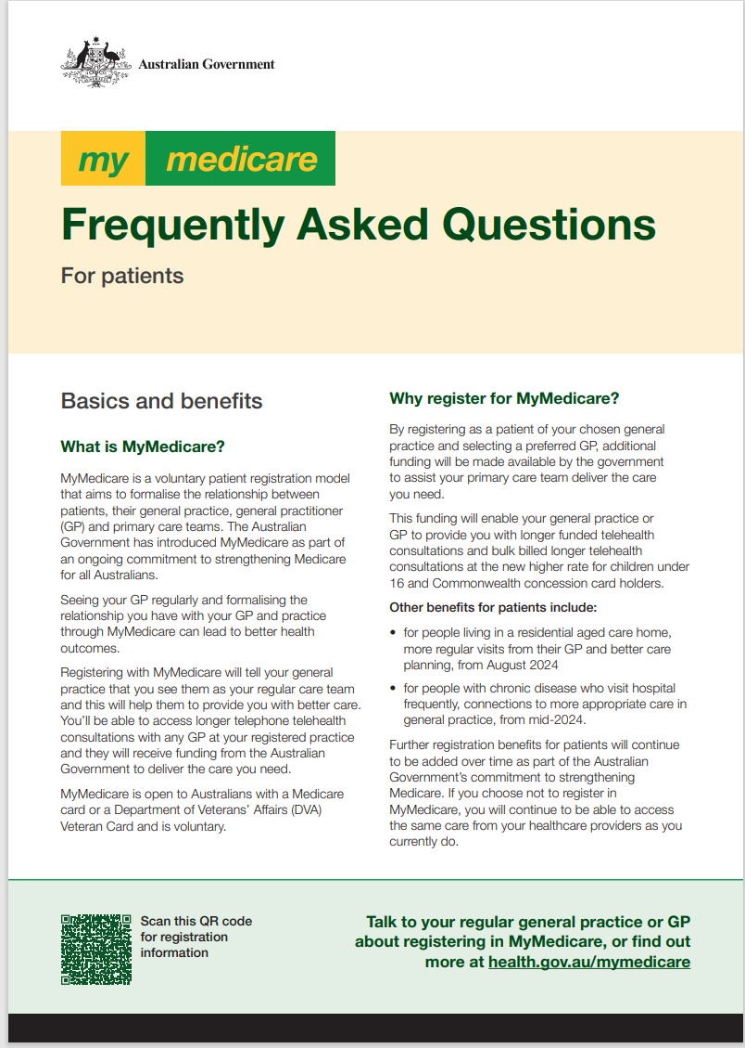
Consumer information
Visit the MyMedicare resources page on the Australian Government Department of Health and Aged Care MyMedicare website

Slide 22
Additional Information
MyMedicare | Australian Government Department of Health and Aged Care
Register for MyMedicare - Medicare online account - Services Australia

Slide 23

Q & A

Slide 24
Building 20, Garden City Office Park
2404 Logan Road, Eight Mile Plains QLD 4113
PO BOX 6435, Upper Mt Gravatt QLD 4122
T: 3864 7555 | F: 3864 7599 | bsphn.org.au
BETTER SYSTEM, BETTER HEALTH

